Slide 1
Term Project Presentation Overview
DSC630-T301
By: Mithil Patel, Gabriel Avinaz, and Joshua Greenert

Slide 2

Problem Statement
To enhance users' shopping experience and help them make correct purchases, Steam Technologies LLC wanted to develop a gaming recommendation system. Not only will it increase sales, but it would assist in developing the company's credibility for consumers' gaming needs
Notes:
The gaming industry is one of the largest growing industries in the world. In fact, the revenue from the gaming industry is projected to be around 365.6 billion dollars for 2023 alone (Statista, 2022)! Therefore, solving this problem is in the interest of any data scientist looking to break into such a massive industry, or to begin learning more about where the industry is going for future years. What a data scientist can learn from these types of projects is based solely on their personal efforts and fascination with learning. In terms of who the project can be sold to, any major gaming industry would pay a considerable sum for a tool that their users can utilize to buy more games through their software, especially if it can accurate make predictions for what the user/client would be interested in.

Slide 3


Data Collection
Notes:
All of our data used throughout this project were obtained through Kaggle.com from users uploading data collected through Steam Technologies LLC. Kaggle is a brilliant source for datasets, especially for budding data scientists. Other sources used for validating information and claims in the gaming industry can be found on the references section of our presentation. The data, specifically obtained from Kaggle, contains Steam user reviews where users have reviewed games they’ve played or purchased to encourage — or discourage — others from purchasing the game, and Steam games on the platform with short descriptions about the games themselves. Both datasets were selected because of their massive size and relevance to the upcoming project. They are useful in solving the problem because the sheer size of the data allow us to feed machine learning models easily to build predictions based on what all is encompassed.

Slide 4
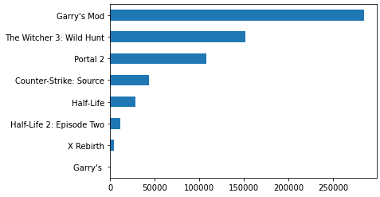
Visualizations
Notes:
When we first started this project, we explored the data by graphing what we could see. We wanted to grasp a better understanding of what data we had, and how we could use this data to tell a story. From the graph above, we could quickly see that some games had excessively more reviews than others. Was this because of the playability? Was this a result of fandom on another level where users only rated games based on ones that others were rating? Being gamers ourselves, it was easy to identify why the sample we grabbed showed a massive amount of support since the games listed with the most reviews were typically providing a lower skill gap. However, that wouldn’t be as transparent to the layman.

Slide 5
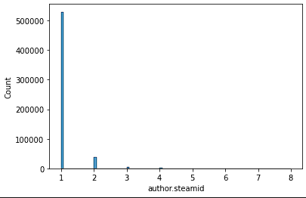
Visualizations
Notes:
Next, we wanted to better understand who our author’s of this data were. We created a graph of steamids — or users — and the amount of reviews they left on games. As you can see from the graph, the data is predominantly one, then descends rapidly. From this information, we could tell that users typically reviewed 1 to 2 games, but rarely reviewed more than 2. This concerned us initially as the data may project a bias when only 1 user has 1 review.

Slide 6

Exploring The Data
What did you find out by exploring the data?
Reviews by Steam were were overwhelmingly bias towards positive recommendations
Games with larger review counts correlate with a higher ratio of positive reviews
The initial dataset only contained review information for 315 games
Majority of user text reviews presented unsuitable data for our content-based approach

Slide 7

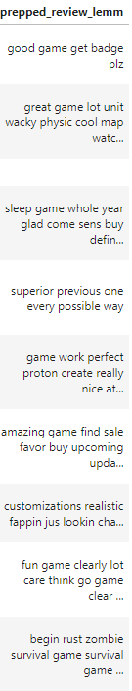
Data Preparation
What steps did you perform to prepare the data?
One-Hot Encoding of categorical data
Adjustments for NAN values in numerical data
Game description and review entries prepared for vectorization
Adjusting case, contractions, and non-alphabetical characters
Tokenization
Stop-Words
Lemmatization

Slide 8
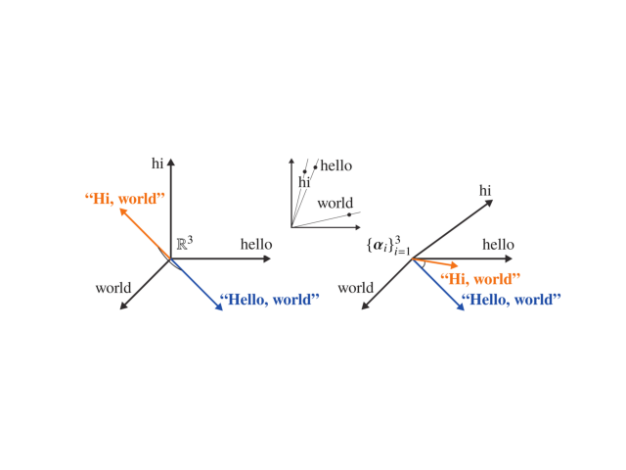
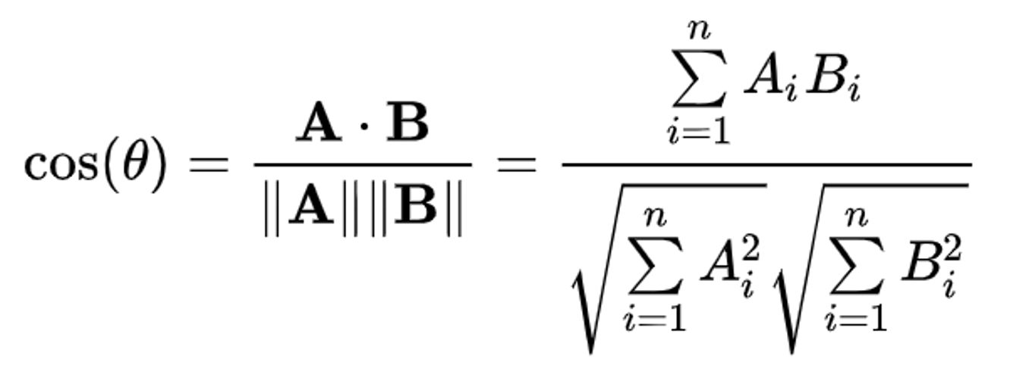
Models & Metrics
What type of modeling are you using on your data?
Collaborative model uses a k-Nearest Neighbor
Content-based model uses TF-IDF Vectorization
What metric(s) are you using to measure your results?
Used the cosine similarity between entries to measure the a game’s closeness
Notes:
For this project, we used two different models so we could ensure the highest accuracy and performance for the data. We chose one supervised learning method (k-nearest neighbors) and one that was unsupervised (tf-idf vectorization).

Slide 9
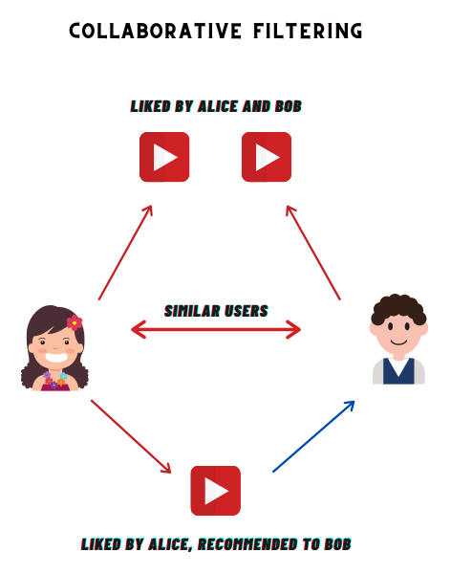
Model Option 1:
Collaborative Filtering
Matrix of Steam users and games with marked recommended games for each user
Utilizes a Compressed Sparse Row (CSR) matrix to alleviate efficiency concerns
Unsupervised SciKit-Learn model Nearest Neighbors to find best matches
n_neighbors: The number of recommendations to make based on the input game
algorithm: uses brute-force algorithm because of CSR Matrix
metrics: cosine distance used as metric to measure the closest neighbor results

Slide 10
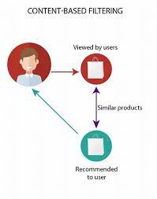
Model Option 2:
Content-Based Filtering
Used Term Frequency-Inverse Document Frequency (TF-IDF) Vectorizer to create sparse matrix of game descriptions
Utilizes Cosine_Similarity from Scikit-Learn to return metrics on each description in the matrix
Cosine similarity measured for every entry in the matrix, passed as both targets and features

Slide 11

Ethical Considerations
What do you need to consider ethically regarding the data, your model and the presentation of results?
Popular games get more reviews due to familiarity
Companies can pay users to post fake reviews
What ethical implications exist, or could exist if this project were live in production?
Social effect: insulating users from exposure to different genre
What could be done to mitigate the ethical concerns, if anything?
Large dataset offset for bias and mitigate impact of fake reviews
Add a filtering system to ensure age-appropriate rating
Notes:
There is potentially a question about bias since more popular games have more reviews, which gain more attention to place it towards the top of the list. Additionally, there is the concern that fake reviews can be supported by various companies; however, both of these issues can be covered with a larger dataset and age-appropriate ratings for users.
User only gets recommendation violent game and how that will shape their perception of reality

Slide 12
Conclusion
What recommendations would you make based off your analysis?
The KNN model (collaborative filtering)
Is your model ready for deployment?
The model is ready for deployment, but we can improve it
What work still needs to be done?
Building web user interface
Add filter for age restrictions
Notes:
Accuracy in the context listed above is reflective of subject matter experts (SME) that were able to review the games from the list while having some familiarity with them and whether they were comparable to other games displayed. Future iterations would be needed to ensure that the model can continue to perform well. Nevertheless, the KNN model yielded the best results overall and would be our recommendation. We believe, based on our individual testing, that it expressed the highest accuracy, highest cosine similarity, and general subjective matching from the team’s perspective.

Slide 13
Results
What did you learn?
Massive data presents severe processing challenges
Results for collaborative and content-based filters present different types of similarities between games
Collaborative models find similar interest between users
Content-based models find similarities in games
Subject Matter Experts (SMEs) are crucial for verification of key results
Notes:
As for the results, teams usually like to reflect on what they’ve learned from the processes that were taken. From this project, we can speak to several points. Frist, massive datasets tend to stress system architecture for several points throughout the process. We encountered these and were lucky to get through them; however, it’s a significant concern for future iterations of similar deployments. Moreover, we learned that different models provide differing results. This result difference may not be very significant at first, but could become an issue later on with additional agile sprints performed. As we dove deeper into the project, we realized that domain knowledge was essential for our analysis; since we were all gamers, we were able to understand when one model was providing bad results over another.

Slide 14
Questions?

Slide 15
References
M., M. (2021) Steam reviews dataset 2021, Kaggle. Available at: https://www.kaggle.com/datasets/najzeko/steam-reviews-2021?select=steam_reviews.csv(Accessed: December 10, 2022)
Milano, Silvia, et al. “Recommender Systems and Their Ethical Challenges - Ai & Society.” SpringerLink, Springer London, 27 Feb. 2020, https://link.springer.com/article/10.1007/s00146-020-00950-y
Statista. (2022, February 9). Video games - worldwide. Retrieved February 14, 2023, from https://www.statista.com/outlook/dmo/digital-media/video-games/worldwide#:~:text=The%20largest%20segment%20is%20Mobile,to%20US%24137.80%20in%202023.
Tristan. “All 55,000 Games on Steam (November 2022).” Www.kaggle.com, www.kaggle.com/datasets/tristan581/all-55000-games-on-steam-november-2022

